Slide 1
Web and Networks IG: Edge Computing Web Exploration
TPAC 2022
13 September 2022

Slide 2
Outline
Summary (40m)
Explainer
Repo: https://github.com/w3c/edge-computing-web-exploration
Rendered: https://w3c.github.io/edge-computing-web-exploration/
Use cases
Stakeholders
General Requirements
Detailed Requirements
Proposals
Discussion (20m)

Slide 3
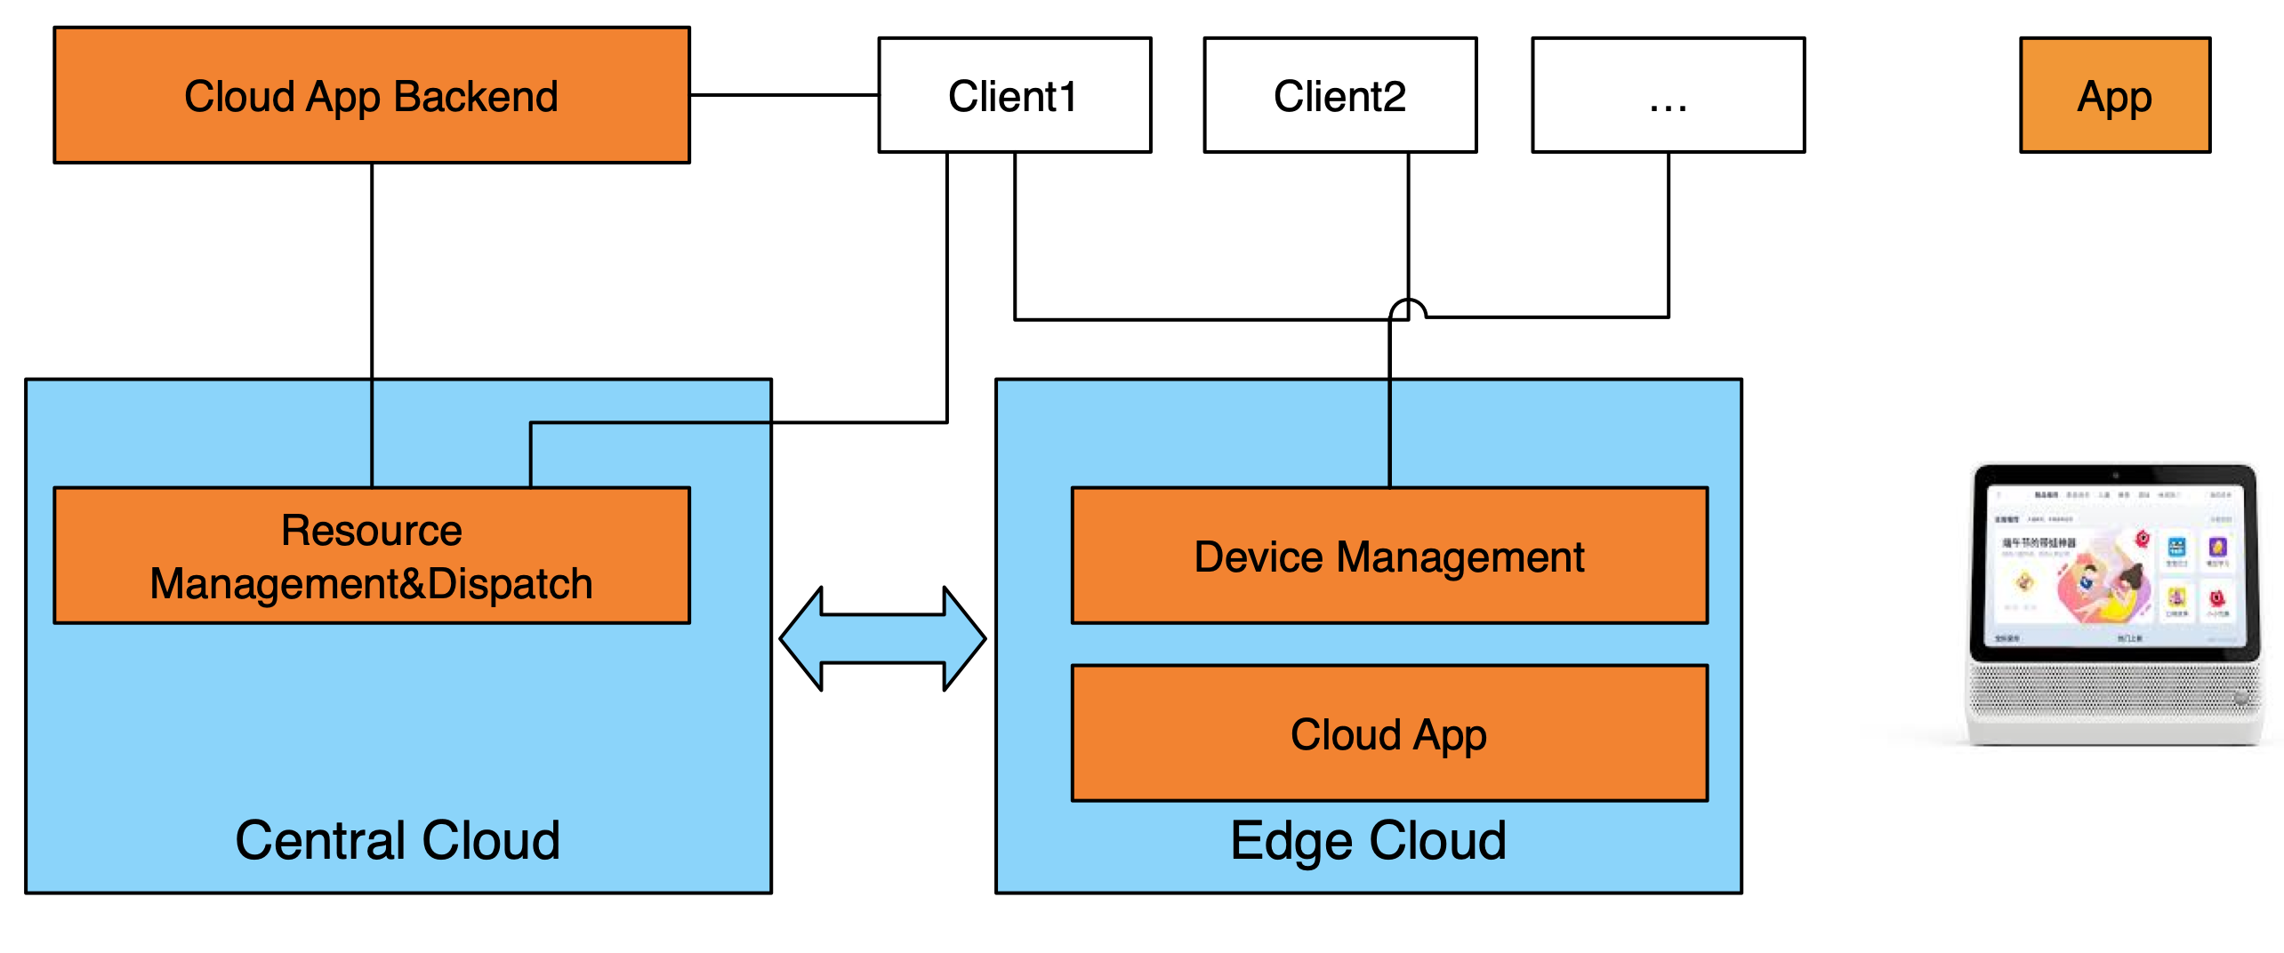


Use Cases(Accelerated work loads, 1/2)
Cloud App
VR/AR Acceleration
Cloud Gaming
Streaming Acceleration
Online Video Conference
Machine Learning Acceleration
Image and Video Processing and Understanding

Slide 4
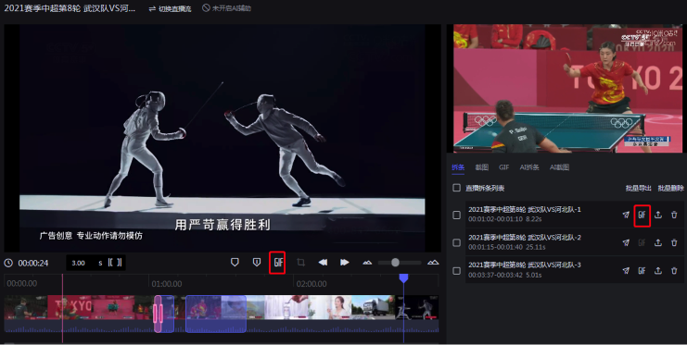
Use Cases(Accelerated work loads, 2/2)
Professional Web-based Media Production
Background Rendering
Live video broadcasting mobile application
Automatic License Plate Recognition
Robot Navigation Acceleration
Child Monitor

Slide 5
Stakeholders
P | Abbv | Category | Business Model | Motivation
 | BWSR | Browser Vendor | OSS - supported by other business (e.g. CSP, ads/search) | More applications can use web
 | CSP | Cloud Service Provider | Usage or subscription, account based (service provider pays) | Offer edge computing service.
 | CDN | Content Distribution Network | Usage or subscription, account based (service provider pays) | Offer edge computing service
 | ISP | Internet Service Provider | Subscription/rental; HW sales in some cases | Offer edge computing service
 | HW | Hardware Vendor | Sale or rental | Desktops/servers as private edge computers
 | NET | Mobile Network Provider (MEC) | Usage or subscription, account based (user pays) | Offer compute utility service
 | OS | Operating System Vendor | Sale or subscriptions to OS licenses; HW co-sales | HW co-sales for edge computers
 | APPL | Application Developer | Sale or subscription to software licenses (or in some cases, ad supported) | Avoid limitations of client and/or cloud platforms
 | SVC | Web Service (API) Provider | Usage or subscription, account based (user pays) | Improved deployment options; increased usage
 | USER | End User | Direct payment, bundled cost, or private HW | Improved performance, lower latency

Slide 6
General Requirements
P | Name | Description
 | Performance | The overall performance of an application using offload, as measured by user responsiveness or time to completion of computational work as appropriate, should be improved.
 | Scalability | Efficient implementation in a virtualized cluster environment (i.e. a cloud system) should be achievable.
 | Flexibility | The solution should allow a variety of compute resources from different providers to be used.
 | Compatibility | The proposed standards should be as consistent as possible with existing web standards to maximize adoption.
 | Resiliency | The solution should allow adaptation to changing circumstances such as changes in relative performance, network connectivity, or failure of a remote Computing Resource.
 | Security | The standards should be consistent with existing security expectations for web applications.
 | Privacy | The standards should be consistent with existing privacy expectations for web applications.
 | Control | The use of resources should ultimately be under the control of the entity responsible for paying for their use.

Slide 7
Detailed Requirements (1/3)
General | Name | Description
Performance | R1: Client Offload. | Client should be able to offload computing intensive work to an edge resource.
Resiliency | R2a: Application-Directed Migration. | The application should be able to explicitly manage migration of work between computing resources. This may include temporarily running a workload on multiple computing resources to hide transfer latency.
Resiliency | R2b: Live Migration. | The edge cloud should be able to transparently migrate live (running) work between computing resources. This includes between edge resources, cloud resources, and back to the client, as necessary. If the workload is stateful, this includes state capture and transfer.
Flexibility | R3: Discovery. | A client should be able to dynamically enumerate available edge resources.
Flexibility | R4: Selection. | A client should be able to select between available resources, including making a decision about whether offload is appropriate (e.g. running on the client may be the best choice). This selection may be automatic or application-directed, and may require metadata or measurements of the performance and latency of edge resources, and may be static or dynamic. To do: perhaps break variants down into separate sub-requirements. Also, it needs to be clear about how this is different from the out-of-scope issue "Offload policy".

Slide 8
Detailed Requirements (2/3)
General | Name | Description
Flexibility | R5: Packaging. | A workload should be packaged so it can be executed on a variety of edge resources. This means either platform independence OR a means to negotiate which workloads can run where.
Flexibility | R6: Persistence. | It should be possible for a workload to be run "in the background", possibly event-driven, even if the client is not active. This also implies lifetime management (cleaning up workloads under some conditions, such as if the client has not connected for a certain amount of time, etc.)
Security, Privacy | R7: Confidentiality and Integrity | The client should be able to control and protect the data used by an offloaded workload. This may result in constraints upon the selection of offload targets, but it also means data needs to be protected in transit, at rest, etc.
Control | R8: Resource Management. | The client should be able to control the use of resources by an offloaded workload on a per-application basis. If an edge resource has a usage charge, for example, a client may want to set quotas on offload, and some applications may need more resources than others. This may also require a negotiation, e.g. a workload may have minimum requirements, making offload mandatory on limited clients. This is partially about QoS as it relates to performance (making sure a minimum amount of resources is available) but is also about controlling charges (so a web app does not abuse the edge resources paid for by a client).

Slide 9
Detailed Requirements (3/3)
General | Name | Description
Scalability | R9: Statelessness | It should be possible to identify workloads that are stateless so they can be run in a more scalable manner, using FaaS cloud mechanisms.
Compatibility | R10: Stateful | It should be possible to run stateful workloads, to be compatible with existing client-side programming model expectations.
Performance | R11: Parallelism | It should be possible to run multiple workloads in parallel and/or express parallelism within a single workload.
Performance | R12: Asynchronous | The API for communicating with a running workload should be non-blocking (asynchronous) to hide the latency of remote communication and allow the main (user interface) thread to run in parallel with the workload (even if the workload is being run on the client).

Slide 10
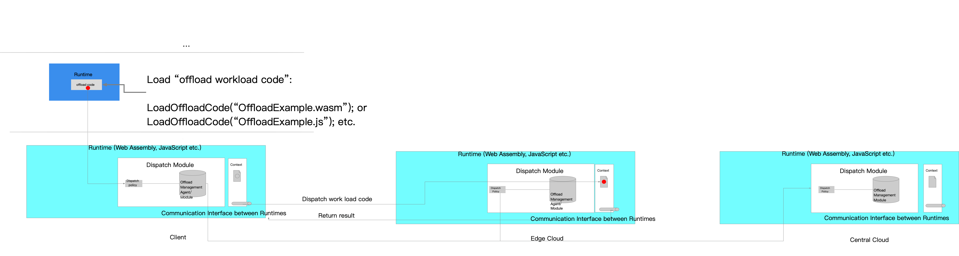
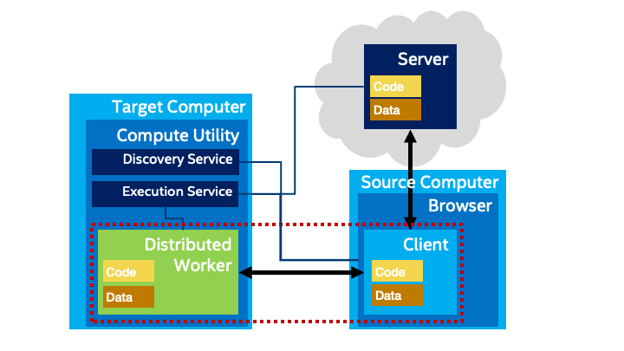
Proposals
Seamless Code Sharing
Seamlessly migrate WASM code between cloud and edge.
Distributed Worker
Extend existing Worker API to support distributed computing using a discoverable compute utility service.

Slide 11
Discussion (20m)
Prioritization
Use cases and Requirements
Workload packaging
JS? WASM?
Compatibility
New API or extension of an existing one?
Additional Stakeholders, Use Cases, or Requirements?
Security and Privacy
Trust model, control (user/dev → diff stds?), relationship to business model
Relationship to same-origin, CORS, OAuth2, etc.; isolation vs sandboxing
User categories: home, enterprise, dev; code (w/ constrained conn) vs. data
Look at trust-over-IP, Web3, SOLID, LAN-PSK, DID/VC

Slide 12
Next Steps
Use github for raising issues (or PRs)
https://github.com/w3c/edge-computing-web-exploration/issues
Capture feedback from this mtg
Participate in WNIG (or CG) meetings
https://www.w3.org/groups/ig/web-networks/calendar
Do we need a dedicated call series? CG? Workshop?
Needs improvement
Trust model; gap analysis and potential resolutions; business models
Improve stakeholder (re)engagement
Motivation
Draft charter for WG?
What deliverables?

